Slide 2
CirkArena – Circular Economy R&D Centre
CirkArena je nově plánovaným výzkumně-vývojovým centrem pro cirkulární ekonomiku soustřeďující excelentní vědecké a inovační týmy a kapacity s ambicí zapojit svá pracoviště v Třinci a Ostravě do systému národních referenčních laboratoří.
CirkArena se zaměří na výzkum a vývoj
Průmyslový odpad specifický pro Moravskoslezký kraj
Bioodpady
Stavební odpady
Notes:
UVÉST ZÁKLADNÍ INFORMACE O PROJEKTU = BUDE DOKONČEN 2027 S CELKOVÝM ROZPOČTEM 2,2 MLD. KČ (STAVBA 60%, MZDY VÝZKUMNÉHO TÝMU 18%, VYBAVENÍ 15%)

Slide 3
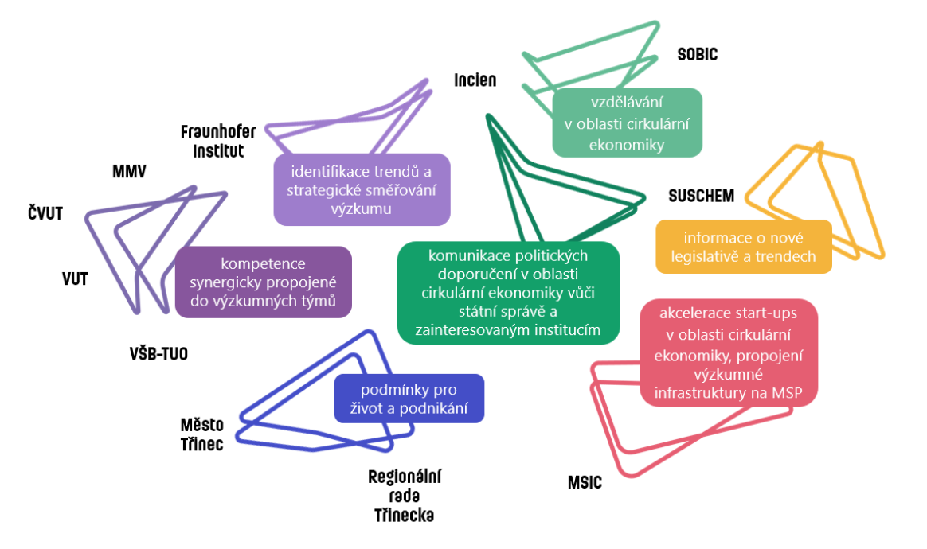
Kdo na projektu pracuje?
Notes:
FTE VaV 62 (Z TOHO 30 NOVÝCH) A 44 THP = CELKEM 106 FTE (Z TOHO 74 NOVÉ)
NAPOJENÍ NA REFRESH A LERCO

Slide 4
Současnou situaci firem si představme jako velkou vlnu
Kdo zachytí vlnu nové regulace - na vlně se poveze k novým příležitostem.
Kdo nezachytí - toho vlna smete...
Proč?

Slide 5
BIG PICTURE - EU Legislation Overview
EU Taxonomy
EU Sustainable Chemistry Strategy
Fit for 55, Net Zero IA
CSRD Reporting Standards + ESRS
CIRCULAR ECONOMY 1.0 (CEP 2015)
CIRCULAR ECONOMY 2.0 (2020+)
FARM TO FORK
STRATEGY (2020+)
PLASTICS STRATEGY
WASTE
PACKAGE
Green claims, Ecodesign
PPWR
2.0+2.1
Food contact material/FCM/ legislations
Good manufacturing
practices/GMP/
Single-use plastics (SUP) directive
Sustainable
Product definition, Green washing,
PEF, LCA
New version of regulation
WASTE DIRECTIVE
PPWD 1.0 Packaging & packaging waste directive
Plastic FCM regulation
Recycled content regulation for food packaging
EPR cost for littering
EPR Modulation
- eco modulation
Recyclability
definition
If we do nothing
we will pay more
If we do nothing
we will not sell and exist
2015
2022
2030

Slide 6
A PARADIGM SHIFT IN THE PACKAGING SUSTAINABILITY
FILLERS & PACKERS - TODAY
FILLERS & PACKERS - TOMORROW
PRODUCT PROTECTION
PRODUCT ECO-DESIGN
IMPACT TO THE ENVIRONMENT
ENVIRONMETAL IMPACT
TECHNOLOGY
GOOD MANUFACTURING PRACTICES
LOGISTICS
PRODUCT PROTECTION
ECONOMY OF SUSTAINABILITY
FARM TO FORK STRATEGY
TECHNOLOGY
“PRODUCT SUSTAINABILITY LANDSCAPE“
WASTE RECOVERY METHOD
WASTE RECOVERY METHOD
PACKAGING & PACKAGING WASTE
LEGISLATION
LEGISLATION
CONSUMER ENGAGEMENT
GREEN CLAIMS
BUSINESS, STRATEGY
TAXONOMY
CUSTOMERS´ PREFERENCES
COMPETITORS

Slide 7
EXAMPLE – PPWR (PACKAGING & PACKAGING WASTE REGULATION)
100% RECYCLABLE BY 2030 – if not = we cannot sell our products /exception for primary pack for pharma/
PACKAGING COMPOSITION – new routine for documentation from suppliers
RECYCLED CONTENT – + documentation
COMPOSTABLE PACKAGING
PACKAGING SIZE REDUCTION All must be documented
RE-USE PACKAGING – all packaging for intercompany & transfers between sites,
PPWR (2024 – 2040)
LABELLING REQIUREMENTS – material composition, share of recycled, renewable materials, re-use
PACKAGING PRODUCERS' OBLIGATIONS – declaration of conformity with PPWR
OBLIGATIONS FOR IMPORTERS, DISTRIBUTORS – registration in registers
HEADSPACE REDUCTION – secondary, tertial Packaging,
BAN ON SELECTED PACKAGING FORMATS
OBLIGATIONS ON SYSTEMS FOR RE-USE, RE-FILL – companies must establish related systems for re-peated use
REDUCTION OF PACKAGING AMOUNT – Bus will be part of the national implementation initiatives

Slide 8
CSRD – EUROPEAN SUSTAINABILITY REPORTING STANDARDS (ESRS)
ESRS 1 - GENERAL REQUIREMENTS
ESRS 2 - GENERAL DISCLOSURES
ESRS E1 - CLIMATE CHANGE
ESRS E2 - POLLUTION
ESRS E3 - WATER AND MARINE RESOURCES
ESRS E4 - BIODIVERSITY AND ECOSYSTEMS
CSRD ESRS
ESRS E5 - RESOURCE USE AND CIRCULAR ECONOMY
ESRS S1 - OWN WORKFORCE
ESRS S2 - WORKERS IN THE VALUE CHAIN
ESRS S3 - AFFECTED COMMUNITIES
ESRS S4 - CONSUMERS AND END-USERS
ESRS G1 - BUSINESS CONDUCT

Slide 9
Děkuji za pozornost.

